Slide 1
Analysis of the factors affecting the trend of talents in the world and the success rate of individual immigration

Slide 2
PART ONE

Slide 3
Purpose
Does the Industry Net Migration Rate will be affected by the Industry Employment Growth Rate?
Is the trend of Industry Net Immigration Rate similar between China and the United States? (2015 - 2018)
Is the trend of Industry Employment Growth Rate similar between China and the United States? (2015 - 2018)

Slide 4
Hypotheses:
As the Employment Growth Rate increases, the Net Immigration Rate of the industry will also rise. (2015 - 2018)
The trend of Industry Net Immigration Rate is not similar between China and the United States. (2015 - 2018)
The trend of Industry Employment Growth Rate is similar between China and the United States. (2015 - 2018)

Slide 5
Design reasoning
Data preparation and Data cleaning
Data processing
Creating bar graph

Slide 6
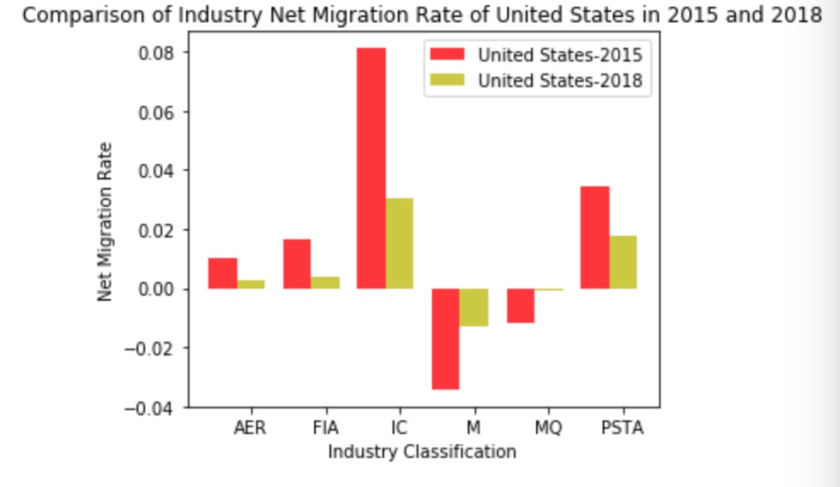
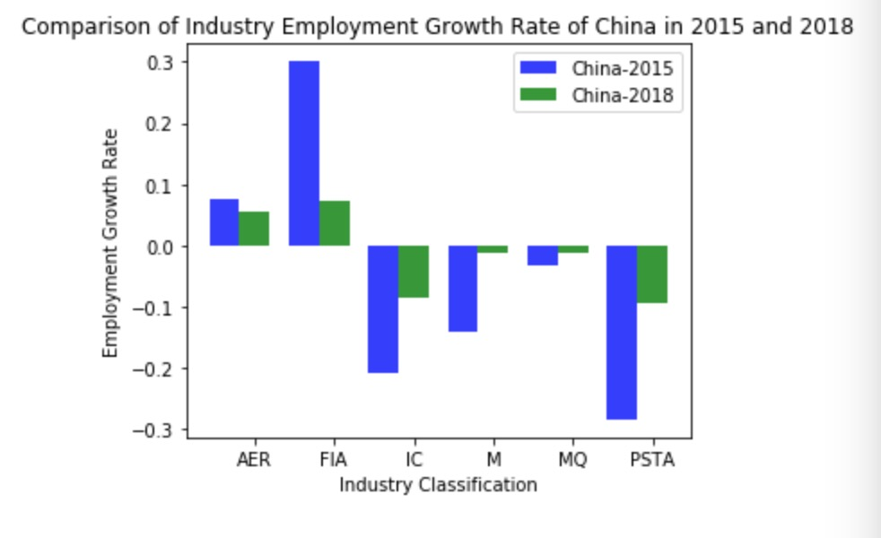
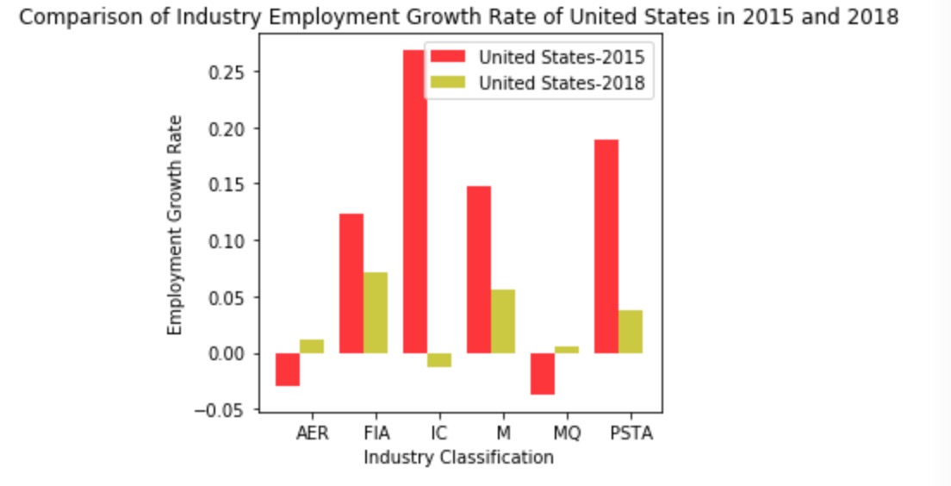
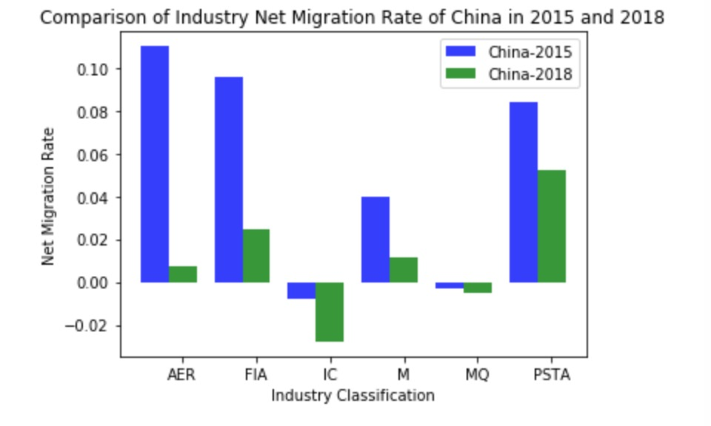
For the first hypothesis, we found that the net industry immigration rate and the industry employment growth rate in the U.S. are positively correlated between 2015 and 2018, in addition to two industry classification (Arts, entertainment and recreation and Manufacturing). However, China has no obvious correlation.
For the second hypothesis, the trend of Industry Net Immigration Rate is similar between China and the United States (2015 - 2018), in addition to manufacturing.
For the third hypothesis, the trend of Industry Employment Growth Rate is basically opposite between China and the United States (2015 - 2018), in addition to Financial and insurance activities.

Slide 7
From 2015 to 2018, the net migration rate of nearly all industries is a downward trend in the United States. The reason may be due to the U.S. immigration policy has tightened in recent years.

Slide 8
We found that there is an interesting phenomenon:
In 2015, the employment growth rate of the Information and Communication industry was far ahead of other industries. The growth rate even exceeds 25 percent. However, in 2018, the employment growth rate of the industry is the lowest in all industries, and it even becomes negative.

Slide 9
For the six industry classifications, the employment growth rate of nearly four industries in China is negative both in 2015 and in 2018. The four industry classifications are: Information and communication, Manufacturing, Mining and quarrying and Professional scientific and technical activities.

Slide 10
Results
For the first hypothesis, we found that the net industry immigration rate and the industry employment growth rate in the U.S. are positively correlated between 2015 and 2018, in addition to two industry classification (Arts, entertainment and recreation and Manufacturing). However, China has no obvious correlation.
For the second hypothesis, the trend of Industry Net Immigration Rate is similar between China and the United States (2015 - 2018), in addition to manufacturing.
For the third hypothesis, the trend of Industry Employment Growth Rate is basically opposite between China and the United States (2015 - 2018), in addition to Financial and insurance activities.

Slide 11
PART TWO

Slide 12
Purpose:
How skill penetration rate impacts the net migration rate of skill migration and industry migration from 2015 to 2018.

Slide 13
Hypotheses:
Skill peneration rate has positive correlation relationship with net migration of skill migration and industry migration

Slide 14
Design reasoning
Merge 4 dataset (industry migration-- industry needs skills--skill migration--skill penetration rate)
Calculate the difference
Drawing plot by using calculated difference value
Find the outlier of skill penetration rate difference

Slide 15
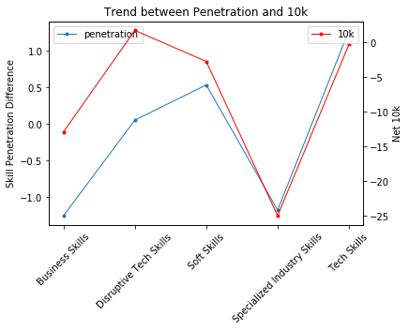
Skill Migration Line Chart
Positive Correlation
Abnormal Skill Category: Soft Skills
Eg: leadership, problem solving
thigh-skilled immigration

Slide 16
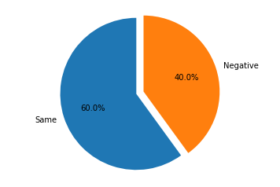
Skill Migration Pie Chart
Skill Penetration Rate and Net Migration Rate Could have different changing trend

Slide 17
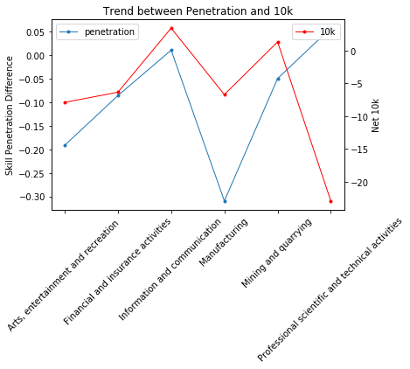
Industry Migration Line Chart
Positive Correlation
Abnormal Industry section: Professional Scientific and Technical Activities

Slide 18
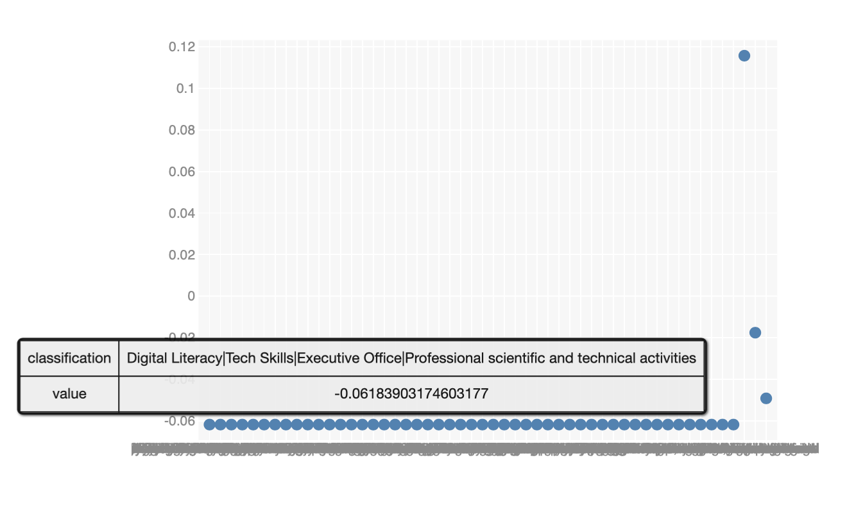
Upper Outlier Scatter Plot
Calculated by skill penetration rate
Y-axis: the value of net_per_10K difference
Classification(X-axis):
skill name/skill category/industry name/industry section
Positive skill penetration rate, Negative 10k net migration rate

Slide 19
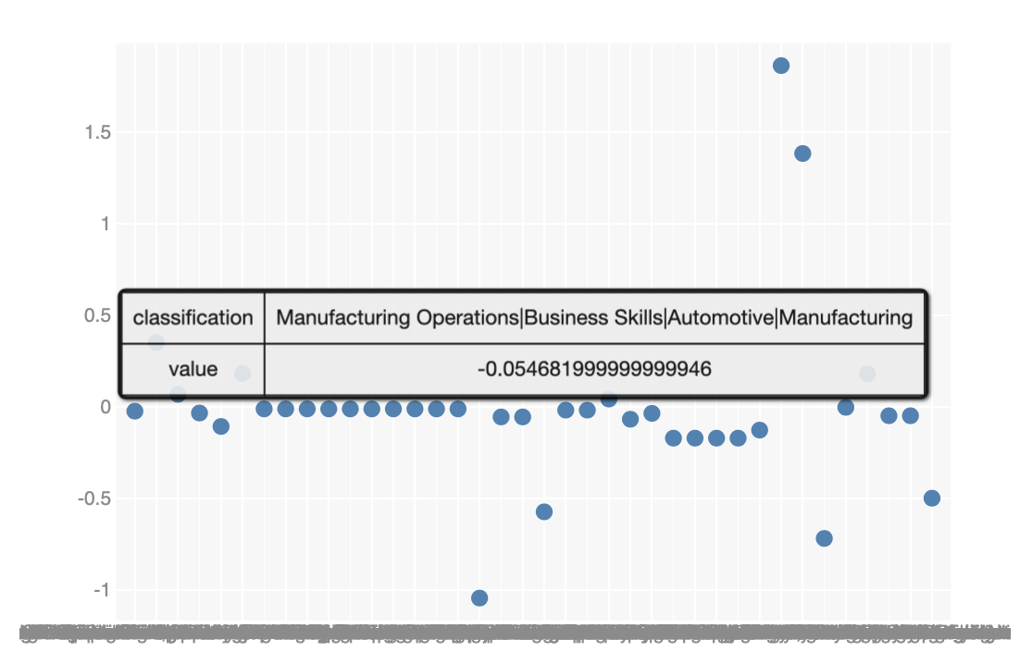
Lower Outlier Scatter Plot
Calculated by skill penetration rate
Y-axis: the value of net_per_10K difference
Classification(X-axis):
skill name/skill category/industry name/industry section
Negative skill penetration rate, negative 10k net migration rate(most of them)

Slide 20
Result
The skill penetration rate has the positive relationship with skill migration rate
The skill penetration rate has the positive relationship with industry migration rate.
Higher skill penetration rate != More opportunity to success
Lower skill penetration rate ≈ Lower opportunity to success

